Slide 1
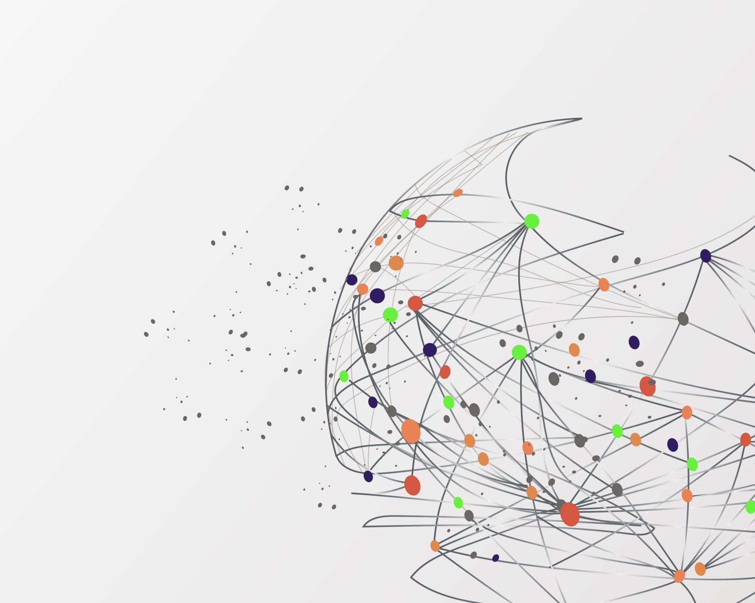
CARIBBEAN STUDIES (CAS) Revision

Slide 2
Composition of Final Exam
Matching
10 Marks
True/False
5 Marks
Multiple Choice
15 Marks
Short Answer
3/8 questions
30 Marks

Slide 3
Review Topics
Society & Culture
Geography (Lesser & Greater Antilles) & Natural Disasters
Hurricanes, Plate Tectonics, Volcanoes, Earthquakes, soil erosion and soil conservation
Inhabitants & Migration:
Explain it, it’s effects & push and pull factors
Plantation, Society, & Social Stratification
Slavery & the Slave Trade
Systems of Production (types & effects)
Creole & Creolisation
Pluralism & Crime
Theories & effects on society
Caribbean Politics & Economic Institutions
CSME, West Indian Federation, IMF, WTO

Slide 4
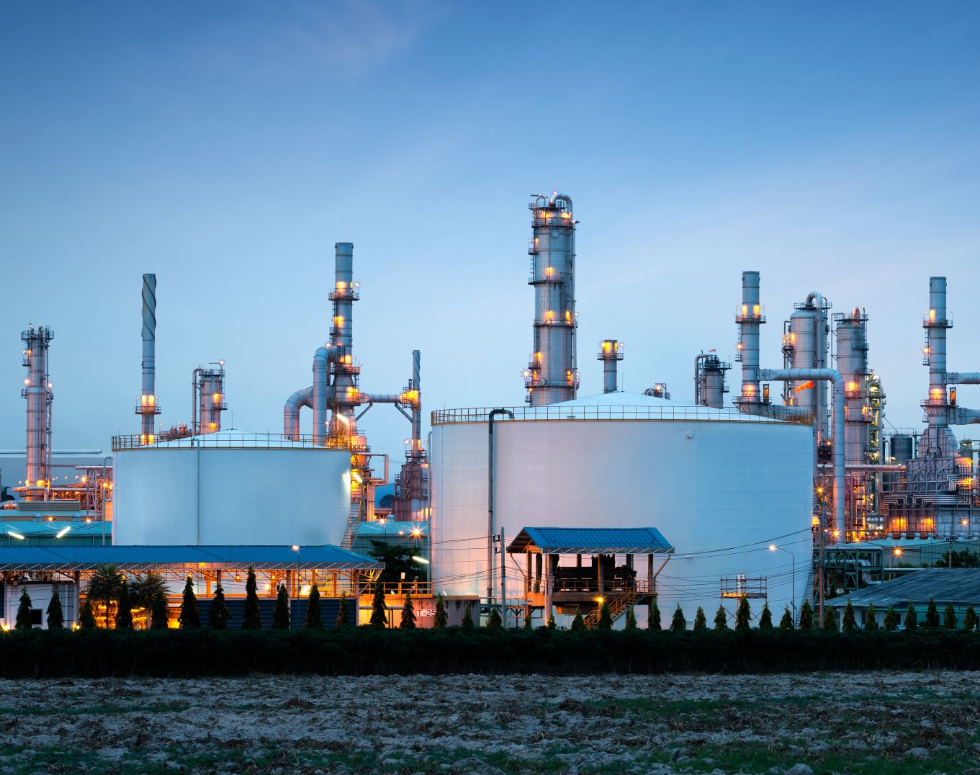
Society
Definition
Characteristics
Types of societies
Hunting & Gathering
Pastoral
Horticultural
Agrarian
Industrial
Post Industrial

Slide 5
Culture
Definition
Levels
National, Regional, Gender, Social Class, Generational, Corporate
Types
Norms vs Values
Cultural values and cultural norms
Cultural Erasure, Cultural Retention, Cultural Renewal, Cultural Creation
Cultural Relativism vs Cultural Ethnocentrism
Hofstede’s Six Dimensions of Culture
Socialization
Agents (Family/Friends/Work/Legal & Penal System)
Types – Primary, Secondary, Gender, Hidden Curriculum
Anticipatory & Organizational/Corporate Socialization
Cultural Manifestation
Social Stratification
(Material vs Non-Material)

Slide 6

Geography
Definition of the Caribbean
Lesser & Greater Antilles
Inhabitants

Slide 7
Natural Disasters
Hurricanes
Drought
Plate Tectonics & Types
Earthquakes
Soil Erosion & Soil Conservation
Volcanoes

Slide 8
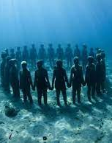
Coral Reefs
Definition
Benefits
Threats

Slide 9


Inhabitants & Migration
What is Migration
Who were the Inhabitants in the Caribbean
Dutch
Spanish
French
English
Influences of each of these inhabitants on the development of the Caribbean culture.

Slide 10
Systems of Production
Encomienda
Repartimiento
White Indentureship
Slavery
Maroonage
Indentureship (Chinese & Indian)

Slide 11
Caribbean Society Models
Plantation Society
Creole Society
Plural Society

Slide 12
Slavery & the Plantation System
Evolution of slavery
indigenous ppl, white indentures, and then enslaved Africans
Chattel Slave
Middle Passage
Stages of the Slave Trade
Effects of the Slave Trade on the development of society
Plantation society, its characteristics, and its aftermath 0r effects.

Slide 13
Pluralism
Society of two or more racial or ethnic groups living in the same area but where there is limited mixing of cultures or intermarriage
Each group maintains some form of its own institutions, e.g. religion, family and education, etc.

Slide 14
Creole & Creolization
Creole/Creolization
process through which various groups in the Caribbean society absorb each other’s cultural products
Origins of Creolisaton
Migration
Slavery
Colonization
Levels of Creole
Upper/Middle/Lower

Slide 15

Crime & Deviance, Theories
Definition of Crime & Deviance
Theories
Strain Theory
Social Process/ Social Learning process Theory
Social Disorganization Theory
Social Conflict Theory

Slide 16
Caribbean Politics & Economic Institutions
West Indian Federation
Purpose
Benefits of this Federation
Downfall of Federation
Jamaica withdrew from the Federation, thereafter Trinidad withdrew
Rivalry between Trinidad and Jamaica
Big countries not prepared to share burden of financing
Failed to establish Direct taxation
Disagreement among territories over polices, like taxation and central planning
Unwillingness on most territorial governments to give up power
Caribbean Single Market Economy (CSME)
Purpose
Benefits of CSME to Member States
Free Movement of Goods & Services
Common External tariff
Common Trade Policy
Right of Establishment of business in any member stats without restrictions
Free Movement of Capital
Challenges

Slide 17
Caribbean Politics & Economic Institutions
International Monetary Fund (IMF)
Purpose
Benefits of this Fund
World Trade Organisation (WTO)
Purpose
Benefits of WTO

Slide 18
Important Terms

Slide 19
Society
Culture
Norms
Values
Cultural Relativism
Ethnocentrism
Acculturation
Assimilation
Social Stratification
Pluralism
Hybridization
Socialization: Primary, Secondary, Corporate, Anticipatory
Creolization

Slide 20
Middle Passage
Mercantilism
Diaspora
Remittance
Chattel Slave
Barracoons

